Slide 1
Welcome to the world of Cambrian Multimedia presentation.

Slide 2
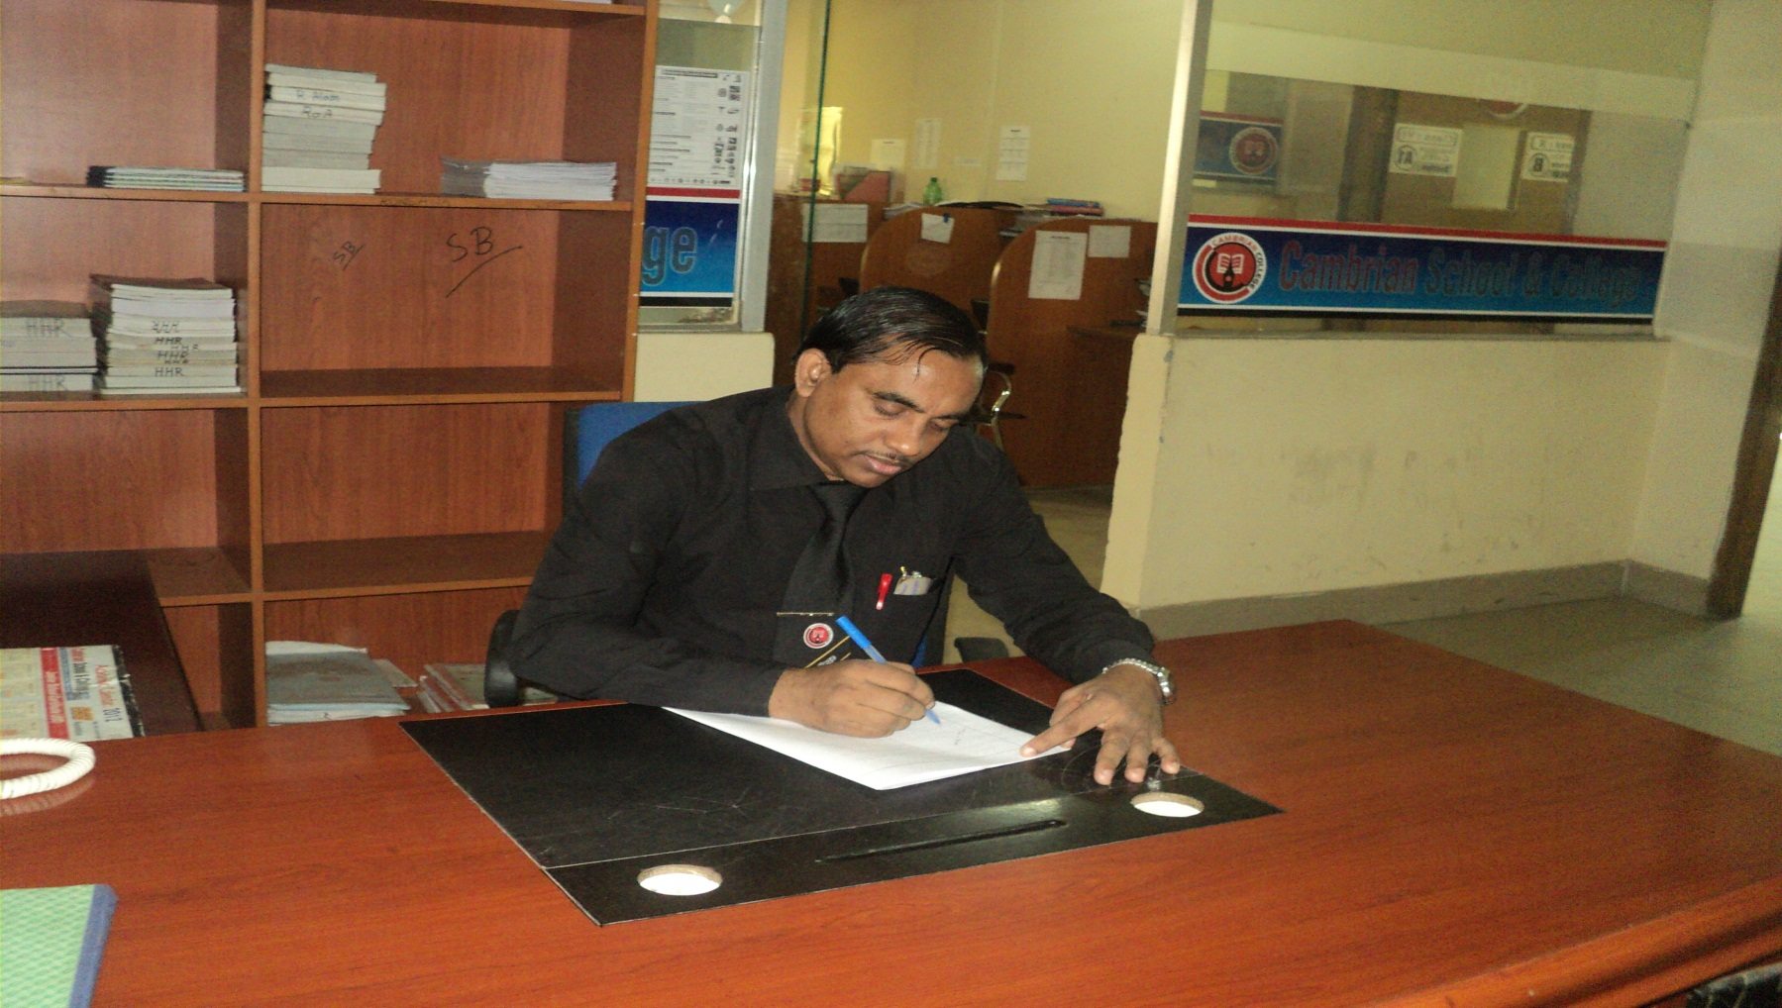
Md Hasan Hafizur Rahman
Senior Lecturer
Department of English
Cambrian School & College,Dhaka,
Class-Eight
English 1st Paper

Slide 3
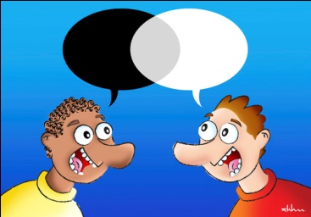
Dialogue

Slide 4
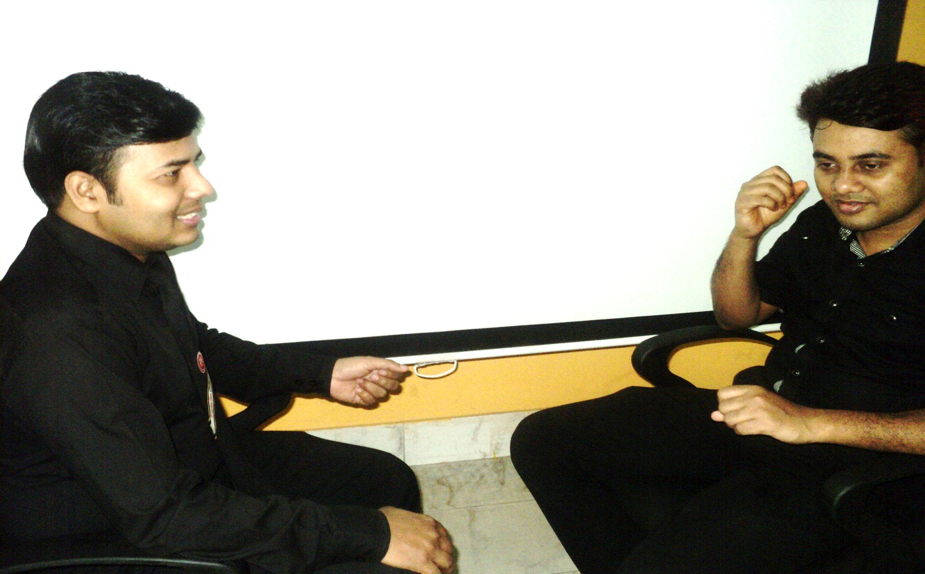
Dialogue

Slide 5
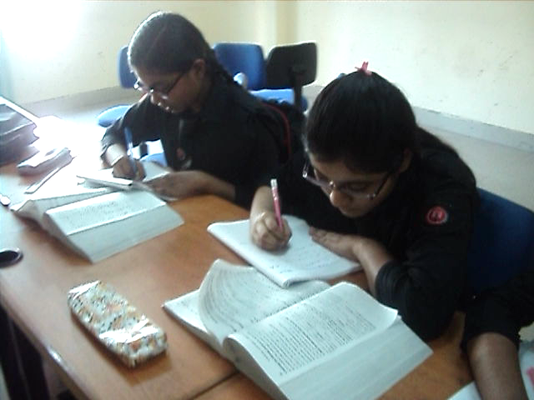
Preparation for the exam

Slide 6
Our Today’s Lesson is-
A dialogue on
“Preparation
for the Exam”

Slide 7
Learning outcomes
After we have studied this lesson we will be able to-
exchange greetings
ask and answer questions
achieve inspiration
write a dialogue.

Slide 8
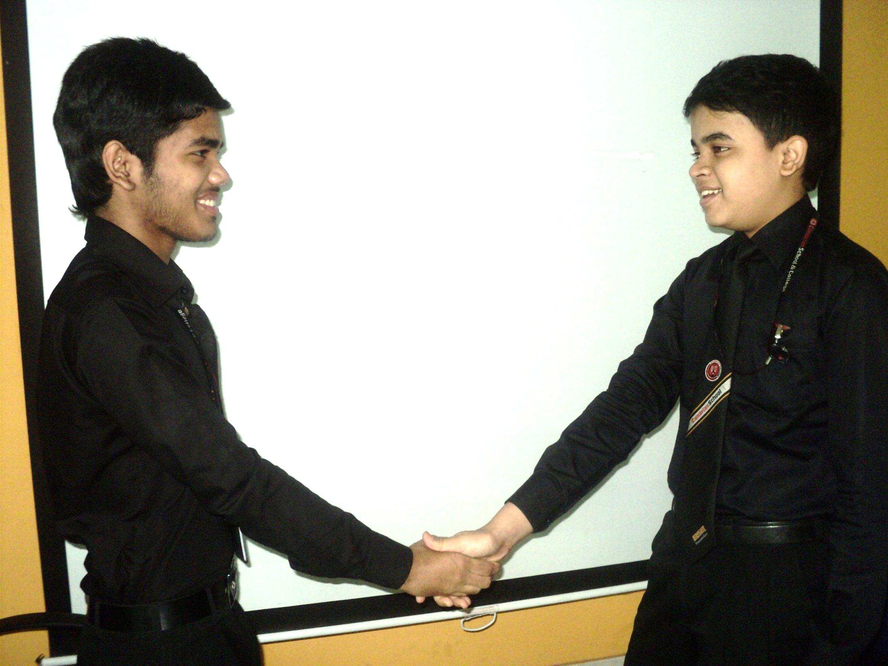

Hi friend, How are you?
I am fine and you?

Slide 9
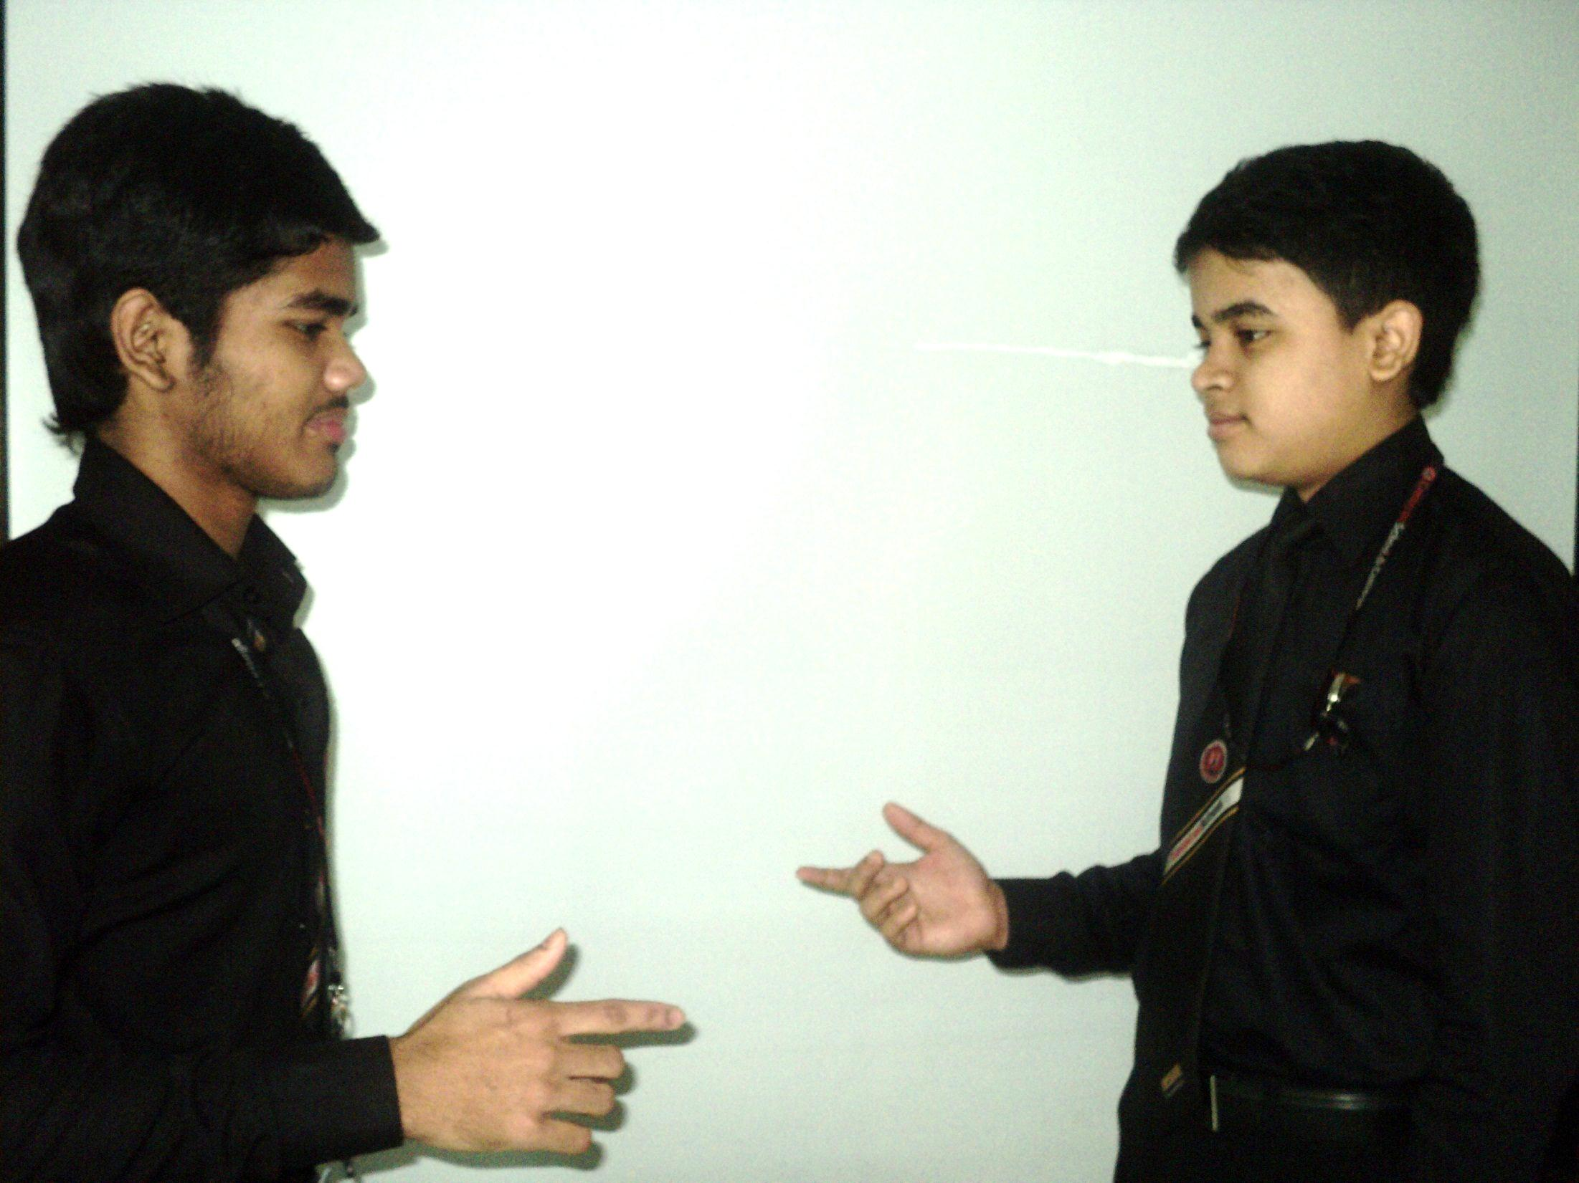
I am also fine but somewhat busy.
But why?

Slide 10
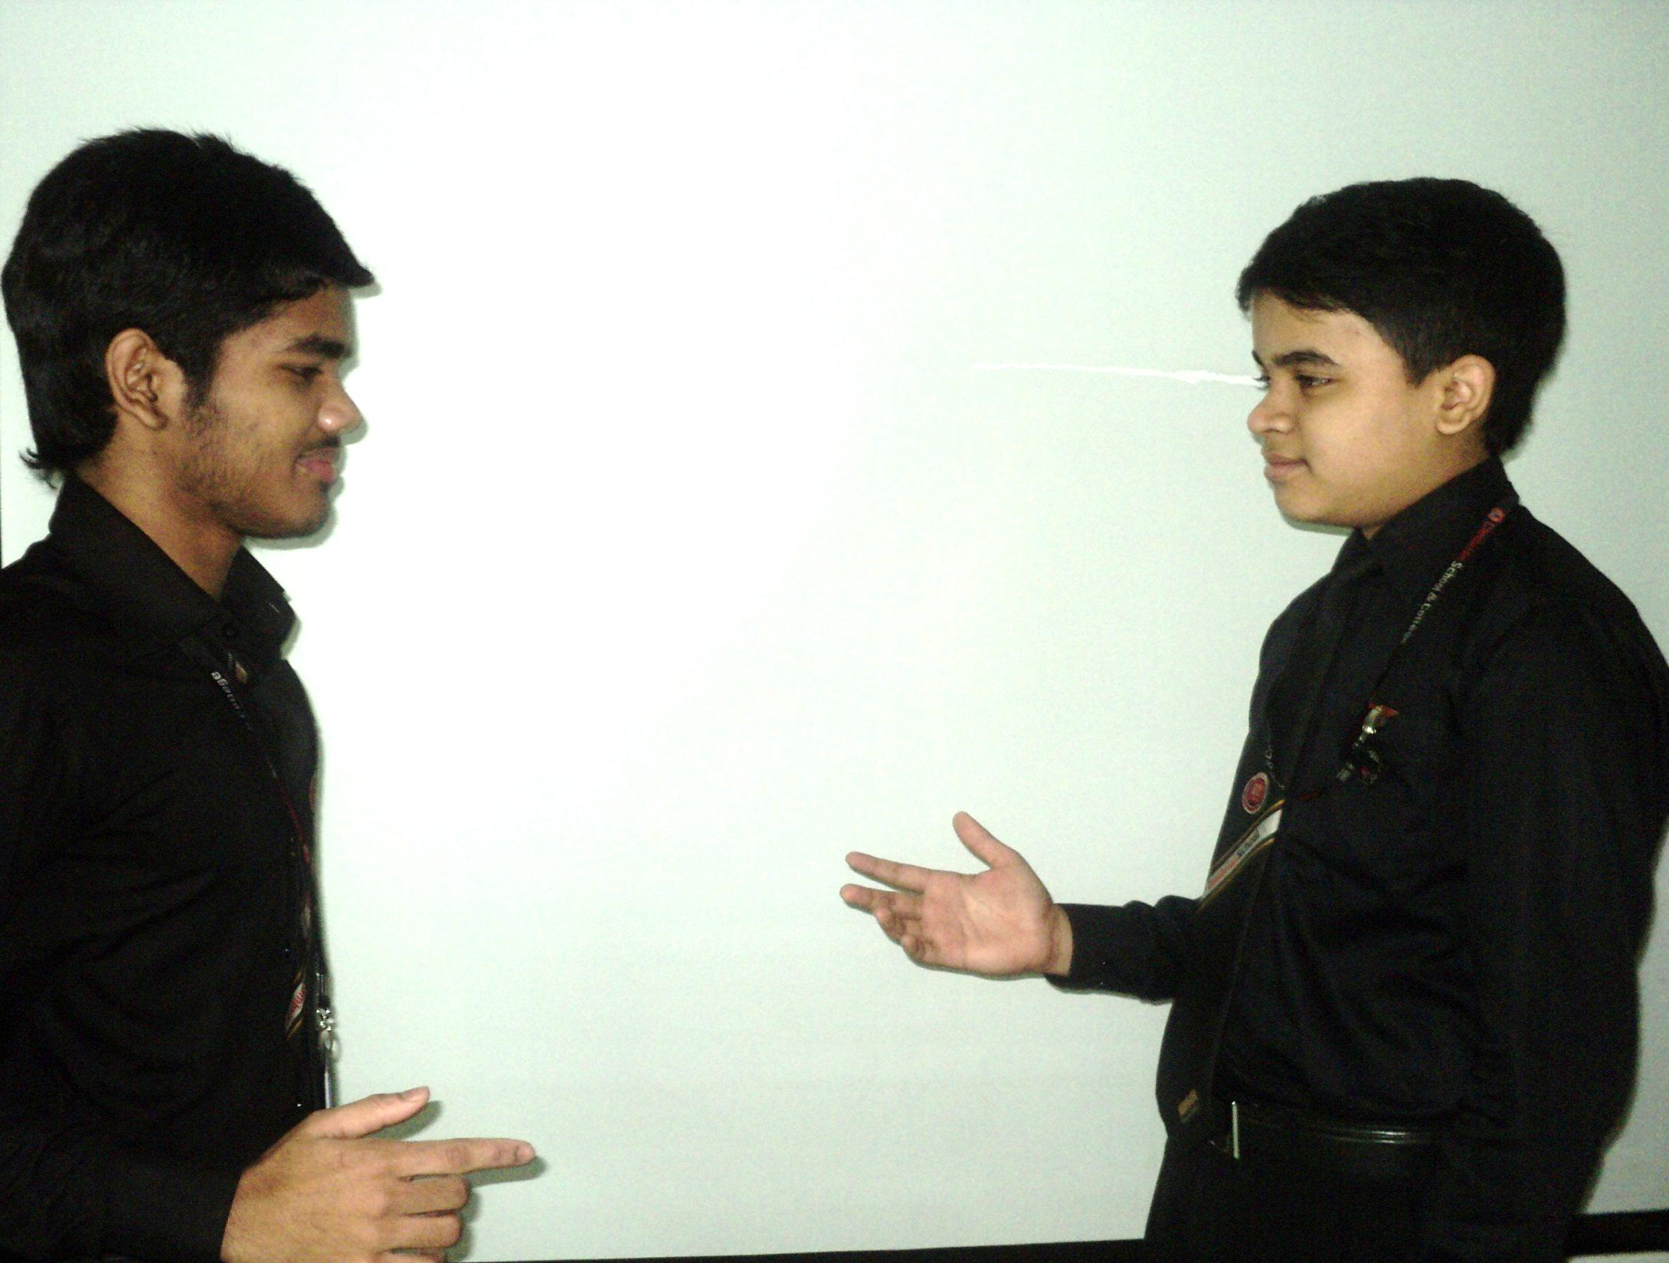
Don’t you know the date of JSC exam?
I am not sure. What is the exact date?

Slide 11
It is 01 November 2014
Really?

Slide 12
Yes.
How is your preparation of the exam?

Slide 13
Well. I have completed 70% of my courses.
70%? But how?

Slide 14
I am very serious about study.
What do you mean?

Slide 15
I mean I always follow a planned routine.
What is the benefit of your routine?

Slide 16
I always have a target. I can go smoothly through the routine.
Would you explain it clearly?

Slide 17
Of course.
Please.

Slide 18
Suppose you need to complete a course. If you divide it in portion of time and target. A routine may help you to complete it.
Your idea is actually very effective.

Slide 19
Now tell me about your preparation.
I have not yet completed all my preparations.

Slide 20
Have you any problem?
You know I am weak in mathematics.

Slide 21
What steps have you taken about Mathematics?
I think I will take help from our Math teacher.

Slide 22
What are the conditions of another subjects?
They are about to complete.

Slide 23
Will you be able to complete other subjects before the exam?
Yes, I hope so.

Slide 24
May you do better.
Pray for me to Allah.

Slide 25
Thank you my friend.
You are most welcome.

Slide 26
Assalamu Alaikum warahmatullah
Walaikum Assalam Warahmatullah

Slide 27
Pair Work
Every single pair is suggested
to write a dialogue on,
“ Preparation for the exam.”

Slide 28
Evaluation
Answer the following questions-
What is preparation of the exam?
Why should we take preparation?
Why is preparation necessary?
What is the benefit of preparation?

Slide 29
Homework
Make a dialogue with your friend about
“Preparation for the exam”

Slide 30
Verse Universal
“Better Preparation,
Better Result”

Slide 31
Bye bye
Good bye

